Slide 1
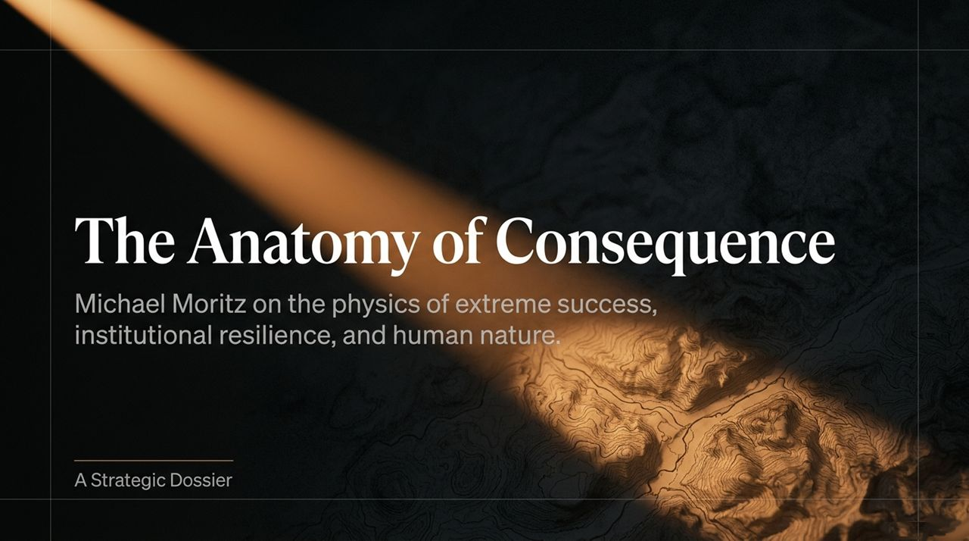
Notes:
Welcome, everyone. Today we are unpacking "The Anatomy of Consequence," an analysis based on Michael Moritz's reflections on extreme success, institutional resilience, and human nature. Moritz—a legendary partner at Sequoia Capital and former journalist—posits that extraordinary achievement is not a collection of happy coincidences or lucky breaks. Instead, it functions almost like a set of predictable physics rooted in early psychological imprinting.
Over the course of this deck, we will examine four core pillars:
Origin: How outsider identity and refugee status create an abiding feeling that disaster is only ever one step away.
Catalyst: The critical "First 14 Years," where early encounters with parental expectations, shame, and survival mechanics permanently imprint character.
Engine: The role of radical monomania—a complete, blinding obsession that eliminates world distractions to execute world-shaping work.
Output: The creation of enduring institutions and historic figures, from Steve Jobs and Elon Musk to Lee Iacocca and Alex Ferguson.
As we move through these slides, remember that Moritz’s philosophy asks us to strip away polished resumes and outward metrics. To understand true impact, we must interrogate the subterranean inner life.
https://www.youtube.com/watch?v=mlWX7RltfDE

Slide 2
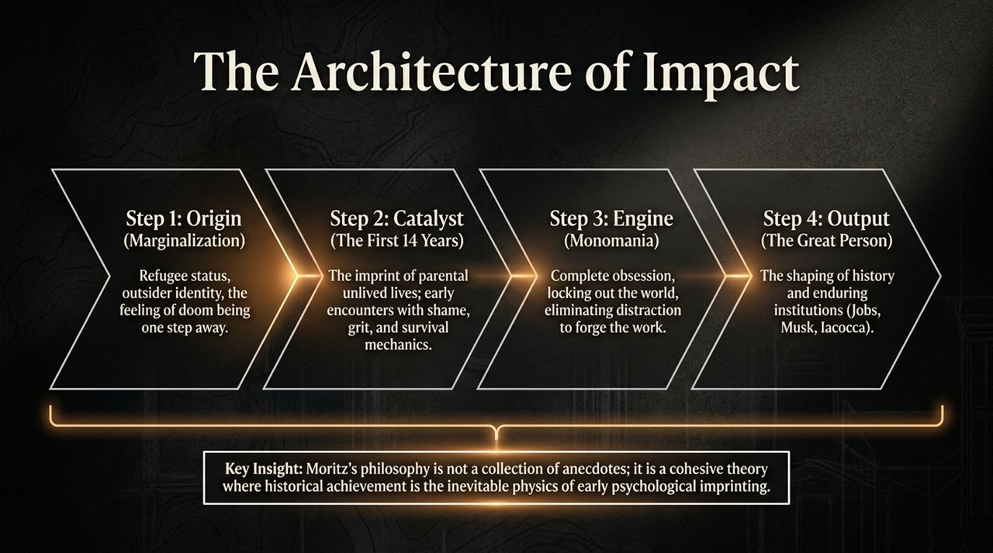
Notes:
This pipeline illustrates the linear trajectory of outlier success. Let’s break down each stage:
Step 1: Origin (Marginalization): Outlier founders and leaders rarely begin from comfortable center-stage positions. Moritz emphasizes how growing up as a minority or refugee fosters an ingrained outsider identity. Even when someone becomes an established insider later in life, the subterranean mind still operates as an outsider living on the edge of a precipice.
Step 2: Catalyst (The First 14 Years): This is where Jung’s concept of the "unlived life of the parent" comes in. Children observe the risks their parents did or didn't take, absorbing both the angels and the demons of their household. Early shame, fear of parental disappointment, and survival mechanics become the fundamental bedrock of their drive.
Step 3: Engine (Monomania): Exceptional output requires total obsession. It means shutting out peripheral joy, family life, and societal norms to hone in on a single objective.
Step 4: Output (The Great Person): The end product is history-shaping impact—building companies like Apple, Tesla, or Chrysler, and structuring institutions that outlast their creators.
Key Takeaway: Historical achievement isn't accidental; it is the inevitable outcome of early psychological imprinting combined with relentless focus.

Slide 3
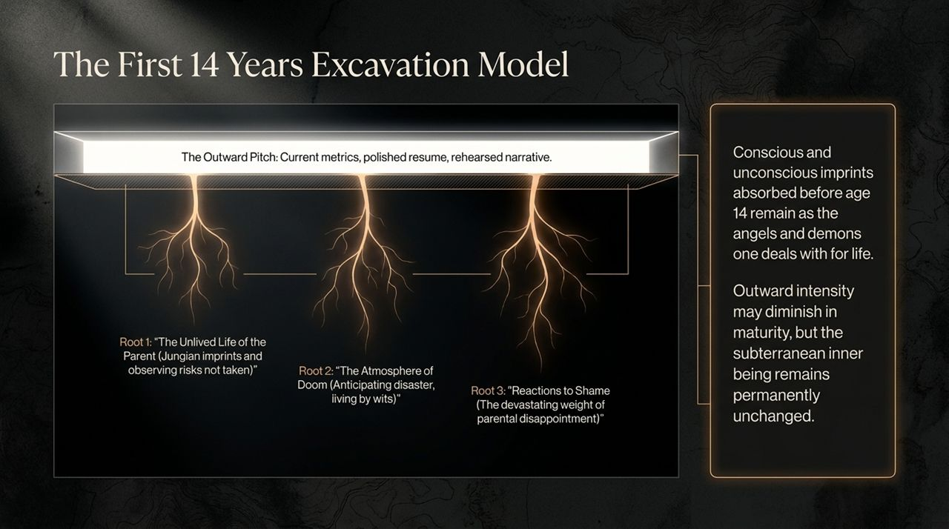
Notes:
When evaluating founders or leaders, standard venture capital and corporate recruiting focus heavily on "The Outward Pitch"—current metrics, polished resumes, and rehearsed narratives. Moritz argues that this surface layer tells you very little about how a person will perform when chaos strikes.
To evaluate true resilience, you must excavate what happened before age 14 across three specific roots:
Root 1: The Unlived Life of the Parent: Children frequently act out or pursue the unfulfilled dreams or untaken risks of their parents.
Root 2: The Atmosphere of Doom: Moritz notes his mother was a perpetual predictor of doom, constantly anticipating disaster. Growing up in an environment where trouble is expected forces an individual to learn to live by their wits.
Root 3: Reactions to Shame: How did the individual handle early failure or parental disappointment?
Whatever conscious or unconscious imprints are absorbed during these formative years remain as the angels and demons a leader grapples with for life. Outward intensity might soften in maturity, but the subterranean drive remains permanently fixed.

Slide 4

Notes:
How do you actually extract these subterranean insights during an interview or evaluation? Moritz compares the diagnostic process to painting on a canvas. Instead of tracing a linear career path, you look for isolated dots—spontaneous, emotional responses to past events.
The high-leverage question Moritz famously uses is: "If you had a chance to do one action differently in your life, what is it that you would do?"
The signal you are searching for is a deep, involuntary emotional reaction rather than a canned business regret (like "I wish I hadn't sold that stock"). Moritz recounts interviewing a candidate for Sequoia who burst into tears when asked this question. The candidate recalled stealing candy at age 12, causing his proud immigrant father severe humiliation. That intense shame formed a lifelong ethical and performance anchor.

Slide 5
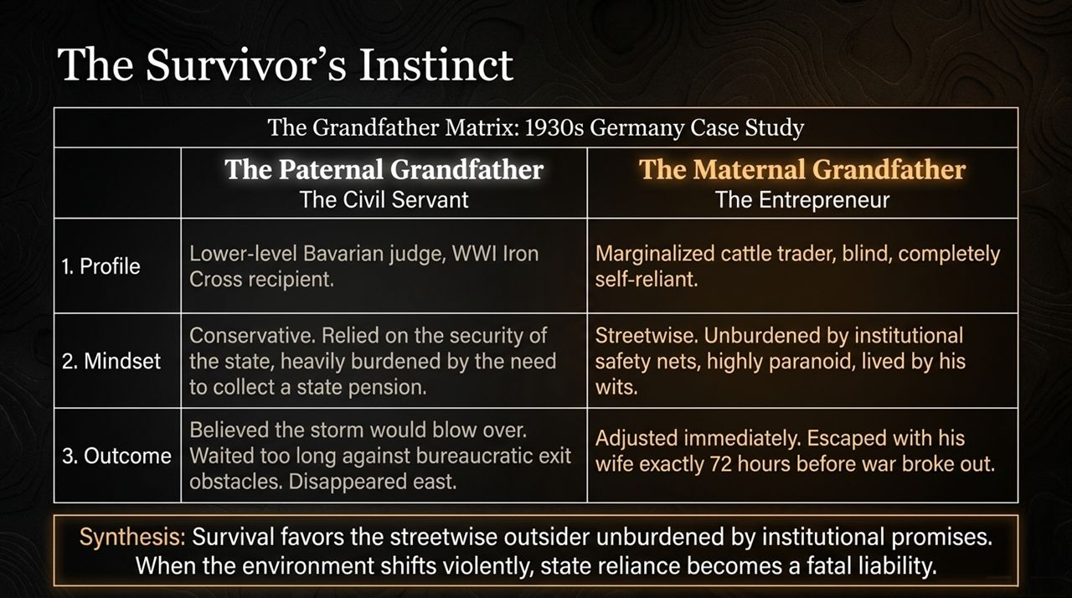
Notes:
This slide highlights a contrast from Moritz's family history in 1930s Germany, illustrating how mindset dictates survival during systemic collapses.
The Paternal Grandfather (The Civil Servant): A lower-level judge and WWI Iron Cross recipient. Conservative and trusting of institutional stability, he relied heavily on his state pension and believed the political storm would blow over. Tragically, by waiting too long, he and his wife were caught in bureaucratic exit traps and perished.
The Maternal Grandfather (The Entrepreneur): A blind, marginalized cattle trader who was completely self-reliant. Unburdened by state safety nets and naturally paranoid, he lived strictly by his wits. Recognizing the danger, he moved immediately, escaping Germany with his wife just 72 hours before World War II erupted.
Synthesis: Survival favors streetwise outsiders who carry no illusions about institutional promises. When the macro environment shifts violently, reliance on state or system stability becomes a fatal liability.

Slide 6
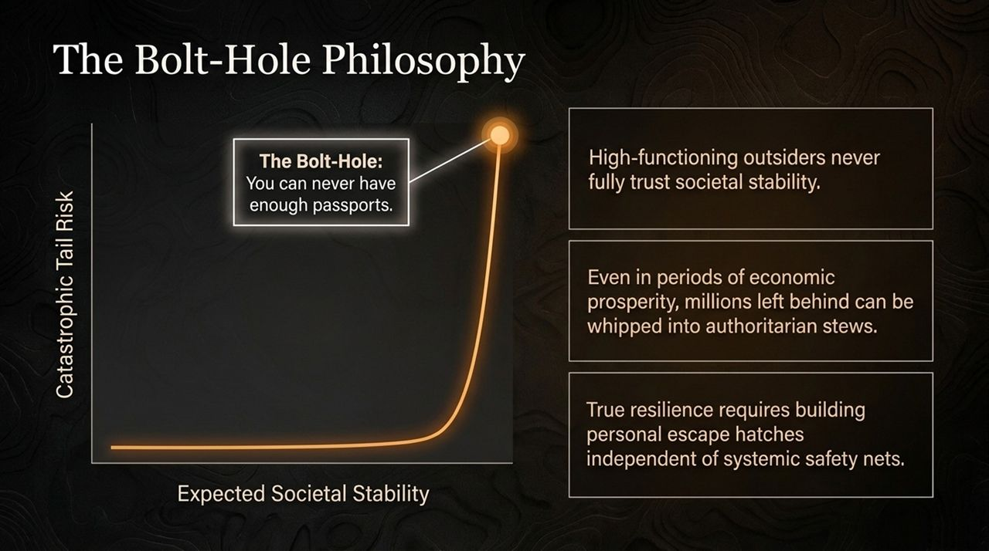
Notes:
This slide plots Catastrophic Tail Risk against Expected Societal Stability. Moritz points out that high-functioning outsiders never fully trust societal or economic calm.
History demonstrates that even during periods of apparent economic prosperity, tens of millions of people who feel left behind can easily be whipped into authoritarian fury by skilled demagogues. Because civil stability can erode suddenly, true personal resilience requires having a "bolt-hole"—a literal or figurative escape hatch, encapsulated by the phrase: "You can never have enough passports."
Whether in business or geopolitics, relying entirely on a single environment or institution leaves you exposed to sudden tail risks.

Slide 7
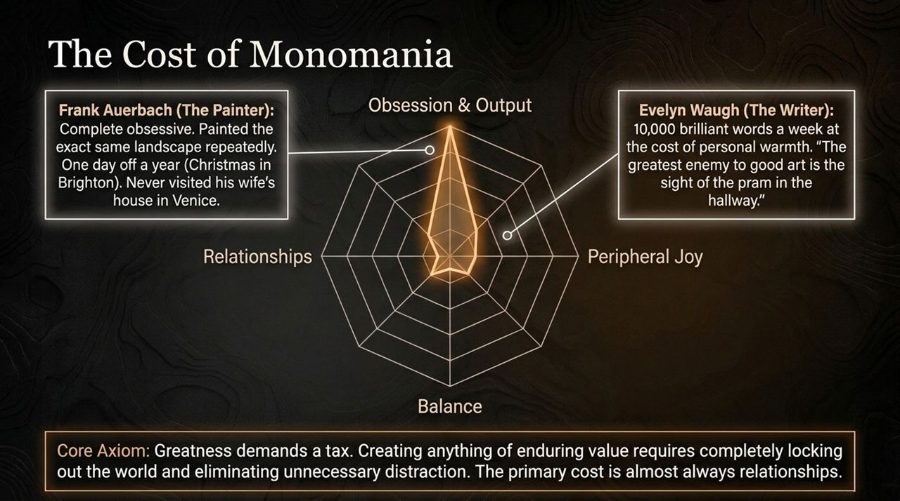
Notes:
Here we examine the concept of monomania—the singular focus required to achieve monumental output. The trade-off is clear: Greatness demands a tax, and that tax is almost always paid in personal relationships and balance.
Frank Auerbach (The Painter): A complete obsessive who painted the exact same landscape day after day. He took only one day off a year (Christmas Day in Brighton) and never even visited his wife's seaside house.
Evelyn Waugh (The Author): Capable of writing 10,000 brilliant words a week, but lacked personal warmth, famously stating, "The greatest enemy to good art is the sight of the pram in the hallway."
To build an institution or create world-changing work, leaders lock out peripheral joys and eliminate all distractions. When evaluating category-defining founders, look for this level of singular, almost ruthlessly hyper-focused drive.

Slide 8
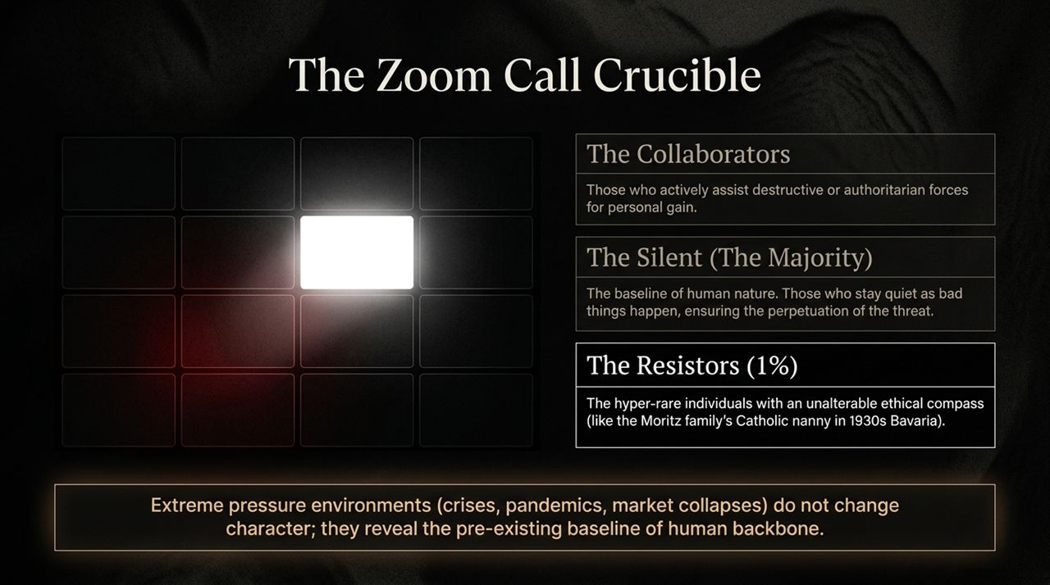
Notes:
During the COVID-19 lockdowns, while conducting meetings on Zoom, Moritz applied a historical taxonomy to evaluate the people on screen. Extreme crisis environments do not alter human character; they strip away pretext and reveal pre-existing integrity.
In any major crisis, human behavior splits into three categories:
The Collaborators: Individuals who actively align with destructive forces for personal gain or career preservation.
The Silent (The Majority): The baseline of human nature. Most people stay quiet to protect themselves, allowing threats or toxic cultures to proliferate.
The Resistors (1%): Rare individuals possesses an unalterable internal ethical compass. Moritz references Anna, his family’s Catholic nanny in 1930s Bavaria, who risked everything to shelter his Jewish family despite severe social and legal threats.
When building teams or investing, seek out the 1% who possess an unwavering backbone when pressure mounts.

Slide 9
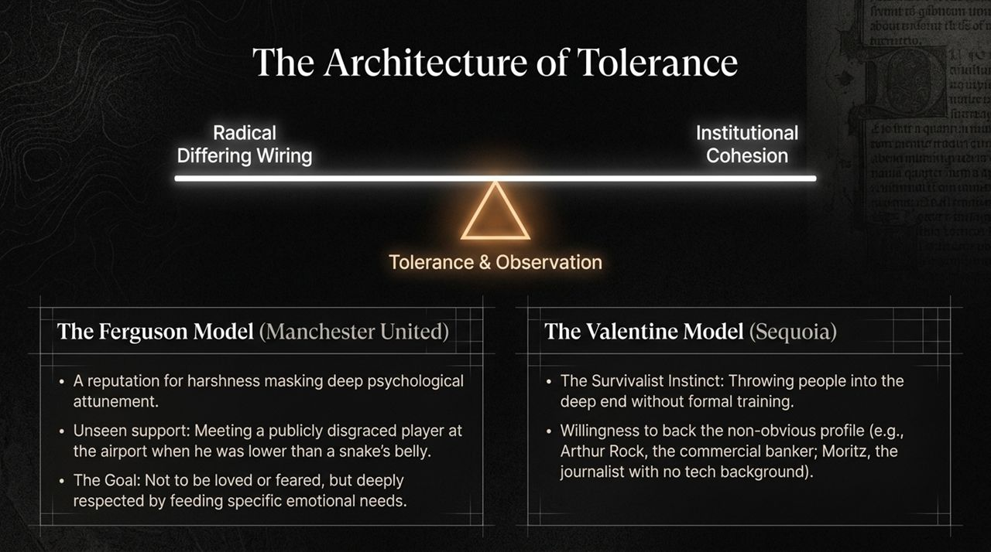
Notes:
This slide contrasts two distinct leadership frameworks that turn individual talent into institutional endurance:
The Alex Ferguson Model: Sir Alex Ferguson built decades of dominance at Manchester United not by seeking affection, but by gaining deep respect. Behind a fierce exterior lay intense psychological attunement. When David Beckham was vilified by the British press after the World Cup, Ferguson met him personally at the airport to offer quiet, out-of-sight support when he was feeling "lower than a snake's belly.“
The Don Valentine Model: Sequoia’s founder believed in throwing people into the deep end without formal training to see if they would swim or drown. He looked past traditional backgrounds, backing unconventional figures like Arthur Rock (a commercial banker) and Moritz himself (a journalist with zero engineering degree).
Both models show that successful leaders manage individuals according to their specific psychological needs rather than enforcing rigid, one-size-fits-all management.

Slide 10
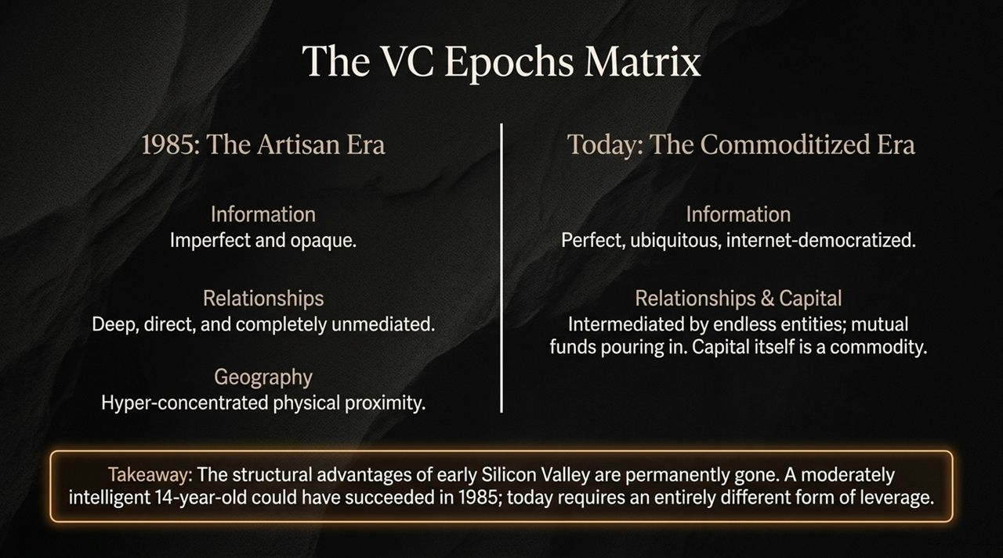
Notes:
Here we evaluate how early-stage venture capital has evolved over the past four decades:
1985 (The Artisan Era): Information was imperfect and opaque. Success depended on physical proximity and direct, unmediated personal relationships. In this environment, a moderately intelligent, observant individual could succeed purely through intuition and direct network access.
Today (The Commoditized Era): Information is instantly democratized via the internet. Capital has become a commodity, flooded by mega-funds and non-traditional players. Intermediaries now separate investors from founders, making true relationship-building harder to maintain.
Takeaway: The structural advantages of early Silicon Valley are gone. Navigating today’s landscape requires distinct forms of leverage rather than relying on informational arbitrage.

Slide 11
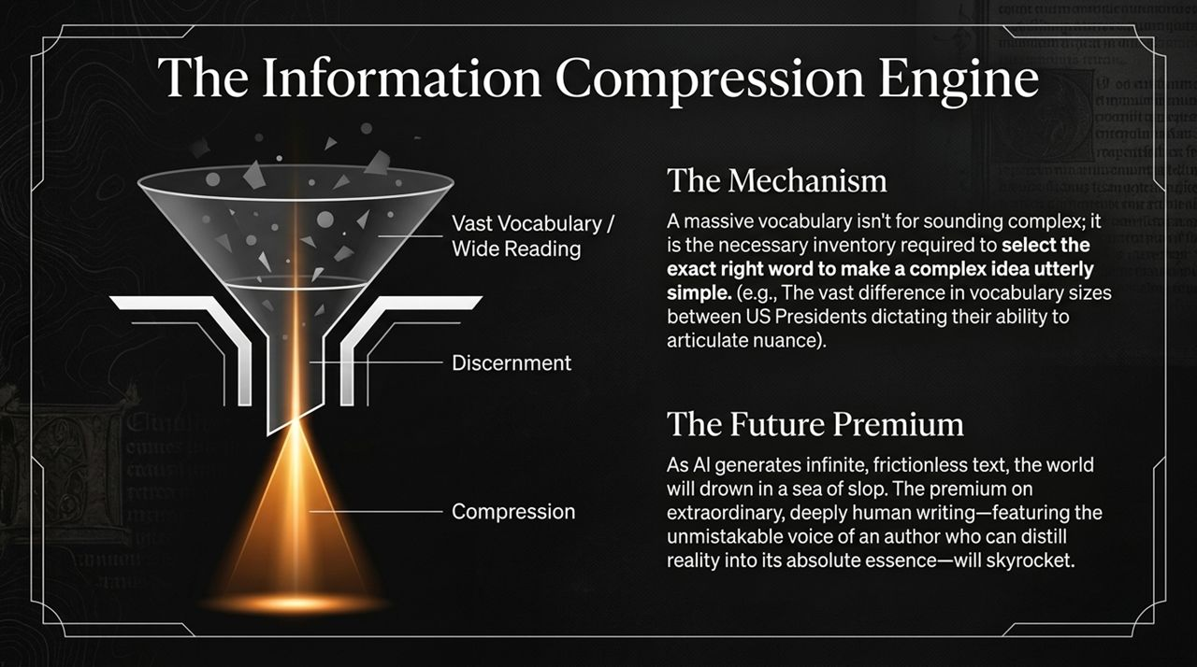
Notes:
This funnel represents the Information Compression Engine—a vital skill for modern leaders.
Mechanism: A vast vocabulary isn't about grandstanding or using complex jargon. It provides the necessary mental inventory to select the exact right word to make complex ideas simple. Moritz contrasts US Presidents to show how vocabulary size directly impacts a leader’s ability to articulate nuance and drive clarity.
The Future Premium: As AI tools generate vast amounts of automated content, the world risks being flooded with generic output. Consequently, the premium on clear, deeply human distillation—where an author or leader cuts through the noise to deliver core truths—will rise significantly.

Slide 12

Notes:
Slide 12 centers on Joseph Campbell’s famous quote: "The privilege of a lifetime is becoming who you are."
Moritz notes that the central struggle for any leader or creator is staying attuned to their inner voice despite external expectations, societal noise, and critics. Stripping away ego means recognizing human insignificance while remaining focused on a single imperative: leaving institutions and structures slightly better than you found them.

Slide 13
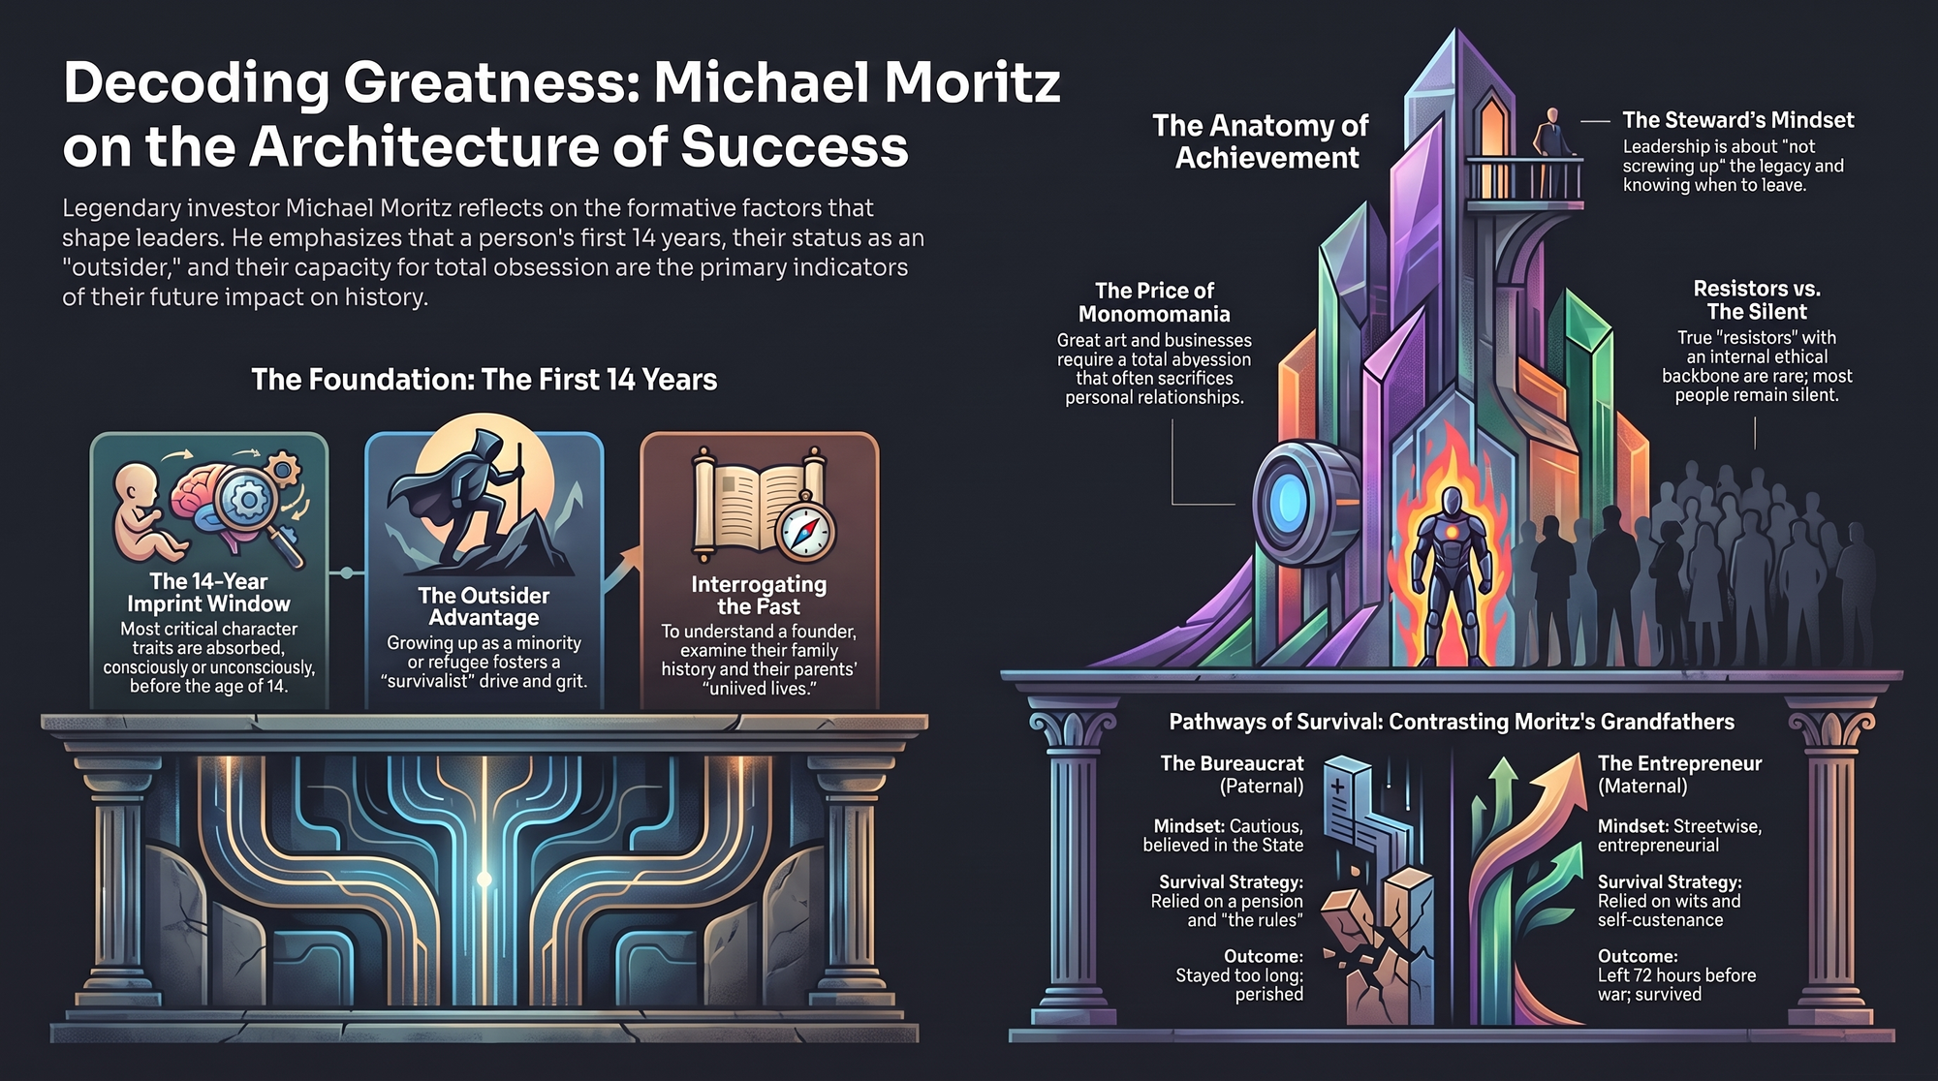
Notes:
To conclude our presentation, Slide 13 synthesizes the strategic dossier:
The 14-Year Imprint Window: Essential drive, ethical frameworks, and fears are established long before adulthood.
The Outsider Advantage: An outsider or minority perspective instills grit and survival instincts that central insiders often lack.
Interrogating the Past: To truly evaluate a leader, look past current pitches and examine their early roots and family background.
Resistors vs. The Silent: True ethical backbone is rare; look for individuals who maintain integrity when systems fail.
The Price of Monomania: Outstanding achievement requires deep focus, often at the cost of personal trade-offs.
The Steward's Mindset: Ultimately, leadership is about honoring the mission, driving performance without resting on past accomplishments, and knowing when to hand over the reigns.
Thank you. I am now happy to open the floor to any questions.
https://www.youtube.com/watch?v=mlWX7RltfDE

